Slide 1

MAT205: Abstract Algebra II
Tutorial
Ma, Jia-Jun

Slide 2
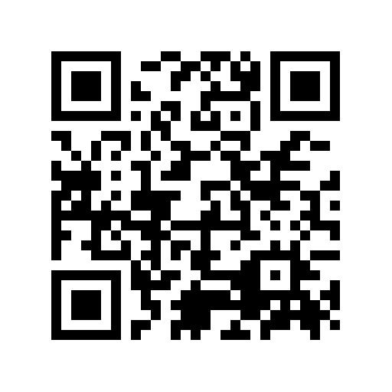
Quiz

Slide 3



Slide 4


Slide 5

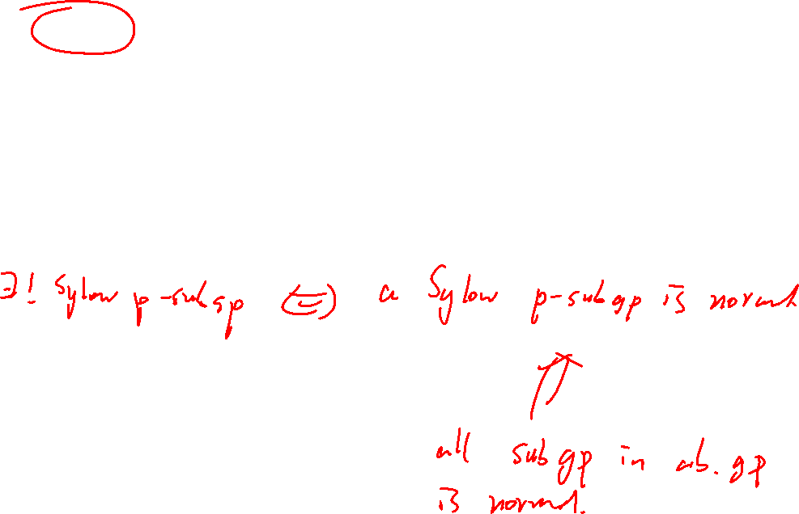

Slide 6

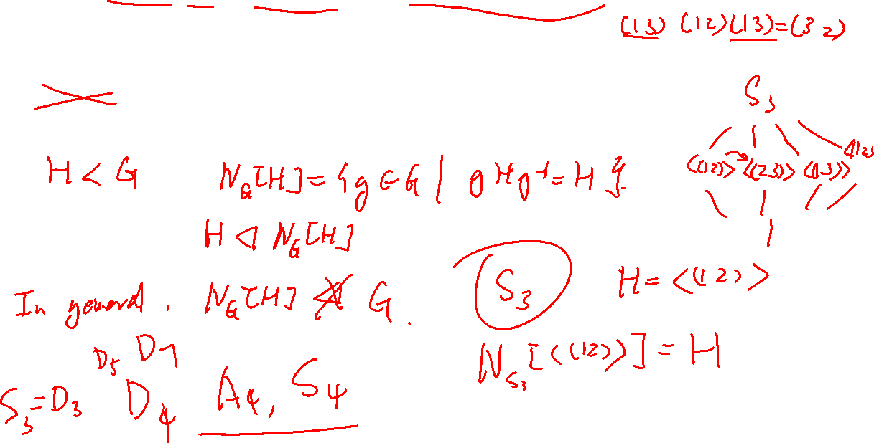

Slide 7

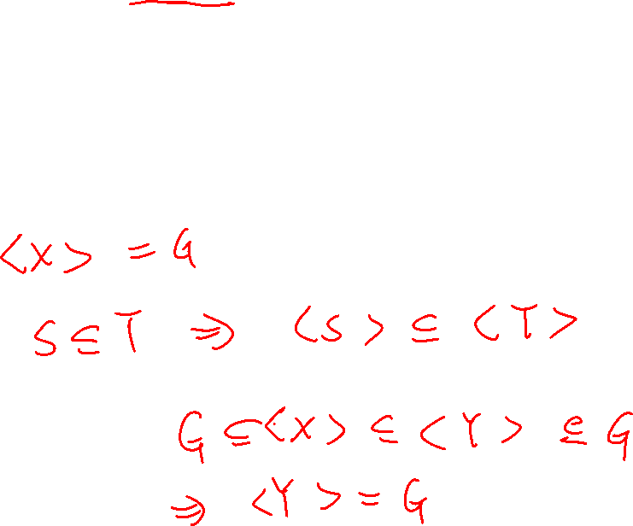

Slide 8

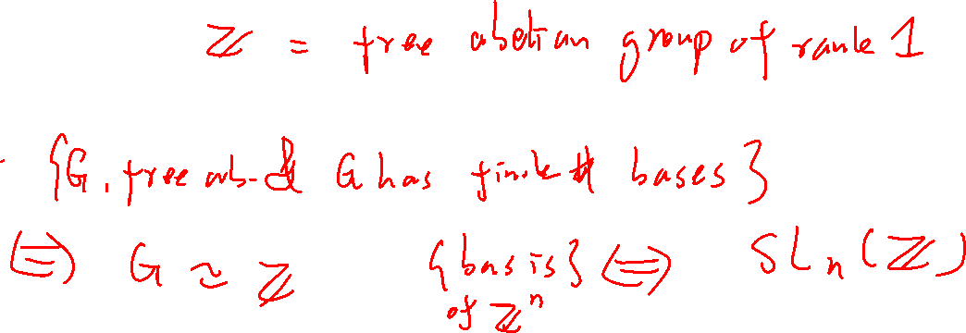

Slide 9

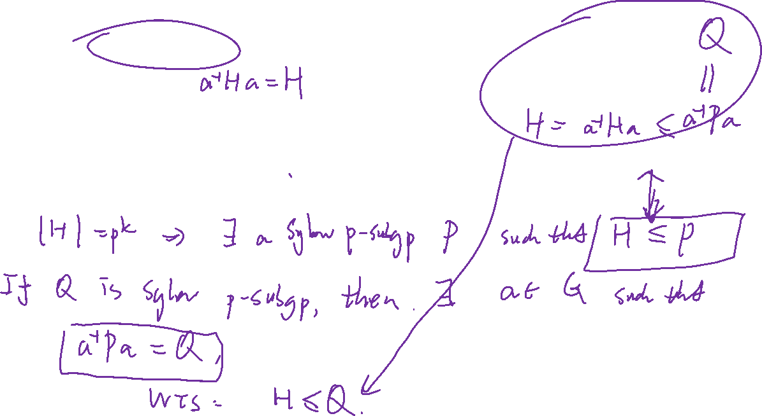

Slide 10

